Slide 1
Fertility/Adult Mortality/Internet Usage
Spencer Leo, Trevor Press, Aaron Tam

Slide 2

Purpose
We intend to examine the correlations between country’s internet availability, mortality rate and fertility rate.
How are these variables related to development?
Are all three of these variables highly correlated?
Are these variables functions of each other?
Does location influence these variables?
Notes:
Hello all,
We are Spencer, Trevor, and Aaron. As part of our project, we study the determining factors of general-well-being for countries and consider the possible policy implications on the relationship between health and economic development. Health and economic development for a country is essential to human happiness and well-being for its citizens. Discerning complex links and variables between general and health and economic indicators can help impact outcomes like poverty reduction or infant mortality rates. Understanding these relationships can help countries sustained health and economic growth.
As part of our project, we choose 2010 annual datasets studying fertility, mortality, and internet rates for countries. These datasets were pulled from the United Nations and World bank database.

Slide 3
Data
We are using two sets of country level data from the United Nations Database and one from the World Bank
Fertility
Data that identities the live births per woman by country in 2010
Mortality
Adult mortality rate (over 35 years of age) per country in 2010
Deaths per 100 of population 35 years of age and over
Internet
Percent of country’s population with access to internet in 2010
Continent
List of countries by continent from Wikipedia. Used for data analysis
Notes:
Data
· Fertility
o
Fertility rates, total
(births per woman) per country in 2010
o
The data is collected
from census reports and other statistical publications from national
statistical offices.
·
Mortality
o
Adult mortality rate
(over 35 years of age) per country in 2010
§
Deaths per 100 of
population 35 years of age and over
o
The data is collected
from most recent health statistics for WHO member states
·
Internet
o
Percent of country’s
population with access to internet in 2010
o The data is collected from telecommunication regulatory
agencies and/or ministries and national statistical offices by means of an
annual questionnaire, and subsequently verified, harmonized and complemented by
International Telecommunications Union.
o We also added continent variables to see if there are similar patterns by geographic location.

Slide 4
Clustering
Notes:
Used all techniques mentioned in class (Partitioning, agglomerative hierarchical clustering, divisive hierarchical clustering, and density-based clustering
158 Countries in our analysis

Slide 5
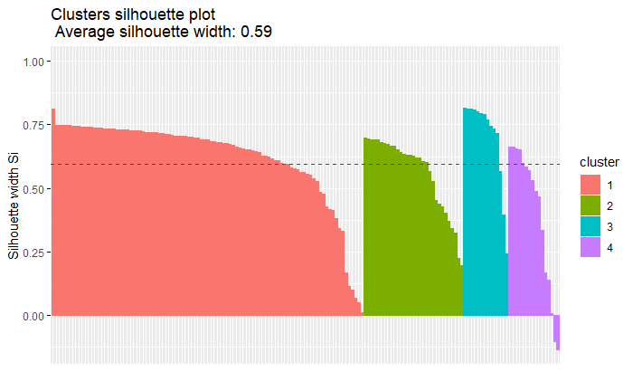
Partitioning Clustering

Slide 6
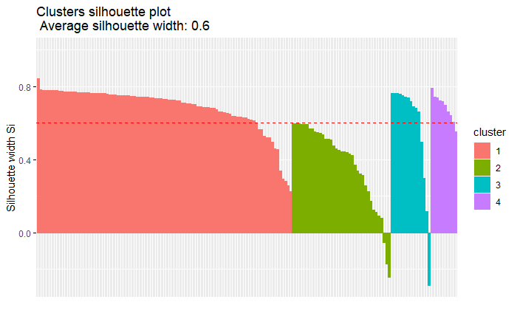
Agglomerative Hierarchical Clustering
Notes:
Several countries in several groups had negative silhouettes meaning that they did not fit into their clusters

Slide 7
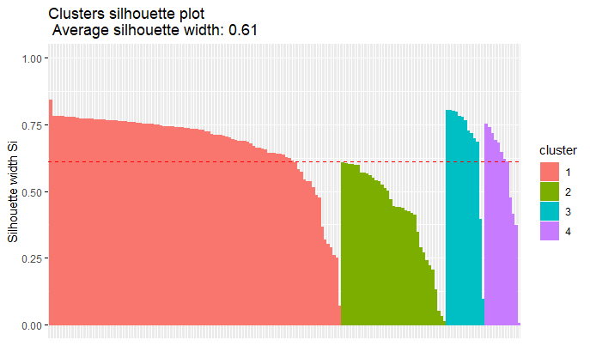
Divisive Hierarchical Clustering
Notes:
Using Divisive Hierarchical clustering we have no outliers that are placed in the wrong cluster
Also, can see that average silhouette width is the largest (.61)

Slide 8
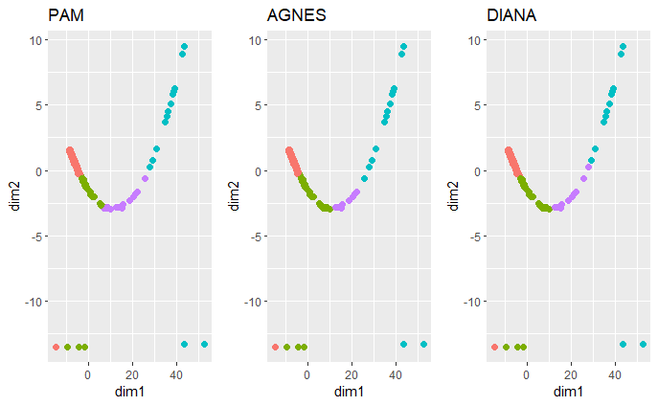
Supervised Clustering
Notes:
Side by side of supervised clustering techniques. It should be noted that diana is the only option without negative silhouettes

Slide 9
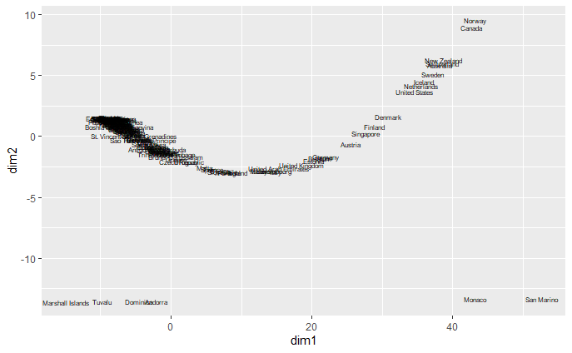
Density Based Clustering

Slide 10
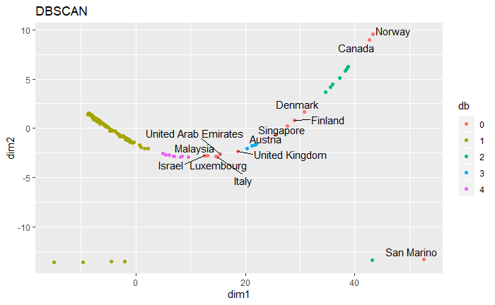
Density Based Clustering
Notes:
13 outliers
Explain social reasons for outliers in clustering
Public Health Care
This allows countries to have low mortality and fertility rates relative to internet usage
Internet was still novel in 2010 and many countries could have adopted it at different levels
Not necessarily in line with their level of economic development

Slide 11
Group Characteristics
Groups | Fertility Rate | Adult Mortality Rate | Internet Usage
0 (Outliers) | 1.903000 | 0.06623077 | 33.611869
1 | 3.654769 | 0.21788800 | 2.417138
2 | 1.804571 | 0.06250000 | 45.080279
3 | 1.442250 | 0.07500000 | 29.553933
4 | 1.657625 | 0.06200000 | 15.286648
Notes:
Group 1 has High fertility, high mortality, and low internet usage (Clearly the largest clusters in all models)
Group 2 has slightly higher fertility rate than groups 2 & 3, usage low mortality, and the highest internet usage
Group 3 has the lowest fertility rate, similar but slightly higher mortality rate to groups 2 and 4, and internet usage between that of groups 2 & 4
Group 4 has slightly higher fertility rate than group 3, the lowest mortality rate, and fairly low internet usage

Slide 12
Clustering
Used all techniques mentioned in class (Partitioning, agglomerative hierarchical clustering, divisive hierarchical clustering, and density-based clustering
Ultimately best method of non-density based clustering was diana
Divisive Hierarchical Clustering
Density-based clustering yielded 13 outliers
Healthcare
Novelty of internet in 2010
Grouped by income levels and ultimately human development
Religious views towards contraception could also play a role
Type of government
Internal, political upheaval
Civil Wars (Afghanistan, Iraq, Sudan, etc.)
Notes:
Should be noted that several countries had extremely high adult mortality rates due to civil wars and other upheaval

Slide 13
Regression
Hypotheses:
Hypothesis 1: Live births per woman will increase as mortality rate increases and internet usage decreases
Hypothesis 2: Live births per woman will increase as mortality rate increases and internet usage decreases controlling for continent
Hypothesis 3: Live births per woman will increase at a decreasing rate as mortality rate increases and internet usage decreases
Hypothesis 4: Live births per woman will increase at a decreasing rate as mortality rate increases and internet usage decreases controlling for continent
Notes:
Rationale: We predict that fertility will decrease in more highly developed nations, and that the mortality rate and internet usage are good indicators of development. Hypothesis 2 controls for continent- predicting that fertility rates will differ substantially between different continents. We also test a 3rd hypothesis and 4th hypothesis where mortality rate has a quadratic relationship with fertility as opposed to a linear relationship. We expect that as mortality rate increases fertility rate increases at a decreasing rate.

Slide 14
Regression
Methods
Explanatory approach
Check assumptions on linearity b/w dependent variable and predictors, normality of residuals, homoscedasticity
Analyze effect of atypical values
Predictive approach
Notes:
Explanatory approach- we find the best fitting model and compare the predicted values of the model vs actual values and find outlier countries
Predictive approach- train a machine learning algorithm on a subset of the data and evaluate the performance of the model. Omitted na values to be able to run the machine learning algorithm.

Slide 15
Regression
Hypo 2 Results:
Estimate Std. Error t value Pr(>|t|)
(Intercept) 3.85351 0.33674 11.444 < 2e-16 ***
MortalityRate1 3.85245 0.85469 4.507 1.35e-05 ***
X.InternetUsage -0.01328 0.00728 -1.825 0.070098 .
ContinentCodeAS -1.57149 0.28508 -5.512 1.59e-07 ***
ContinentCodeEU -2.39473 0.32253 -7.425 9.08e-12 ***
ContinentCodeNA -1.50730 0.32489 -4.639 7.78e-06 ***
ContinentCodeOC -0.62563 0.38352 -1.631 0.105014
ContinentCodeSA -1.44093 0.37249 -3.868 0.000165 ***
R-squared 0.699724
Hypo 4 Results:
Estimate Std. Error t value Pr(>|t|)
(Intercept) 1.872137 0.427779 4.376 2.31e-05 ***
MortalityRate1 17.450006 2.240804 7.787 1.26e-12 ***
MortalityRate2 -19.223314 2.982669 -6.445 1.66e-09 ***
X.InternetUsage 0.004692 0.007010 0.669 0.50435
ContinentCodeAS -1.074269 0.263381 -4.079 7.49e-05 ***
ContinentCodeEU -1.715911 0.303758 -5.649 8.43e-08 ***
ContinentCodeNA -1.051267 0.295589 -3.557 0.00051 ***
ContinentCodeOC -0.474914 0.339593 -1.398 0.16413
ContinentCodeSA -0.919237 0.338857 -2.713 0.00749 **
R squared 0.7656866
Signif. codes: 0 ‘***’ 0.001 ‘**’ 0.01 ‘*’ 0.05 ‘.’ 0.1 ‘ ’ 1

Slide 16
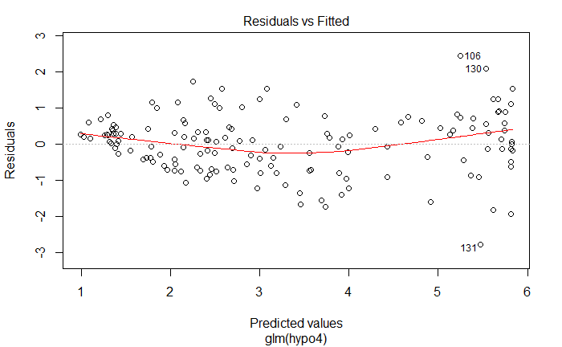
Regression (Hypo 4)
Notes:
Linearity between dependent variable and predictors should follow a linear, horizontal trend

Slide 17
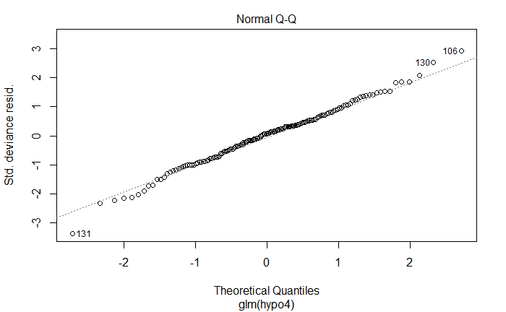
Regression (Hypo 4)
Shapiro-Wilk normality test
W = 0.99307, p-value = 0.6783
Notes:
Normality of residuals is assumed

Slide 18
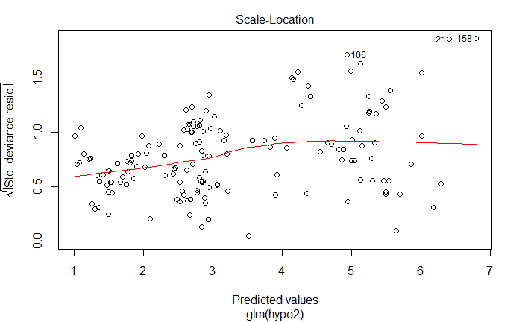
Regression (Hypo2)
Studentized Breusch-Pagan test
BP = 32.659, df = 7, p-value = 3.065e-05
Notes:
Test for homoscedasticity

Slide 19
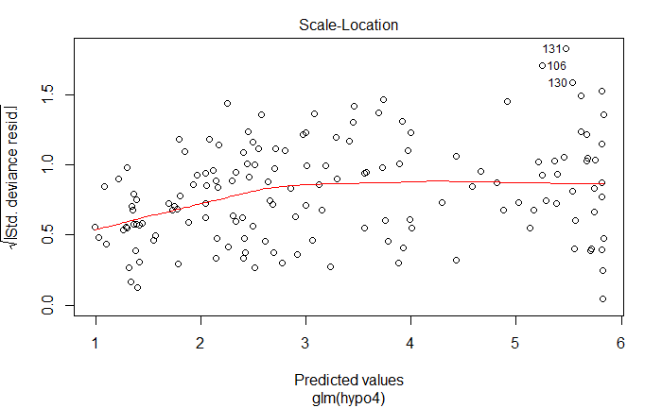
Regression (Hypo 4)
studentized Breusch-Pagan test
BP = 18.716, df = 8, p-value = 0.01645
Notes:
Homoskedascity

Slide 20
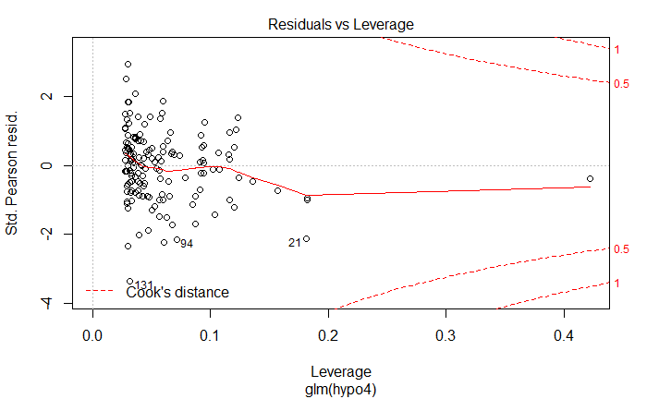
Regression (Hypo 4)
Notes:
Analyze the effect of atypical values. Determine if outliers are influential.

Slide 21
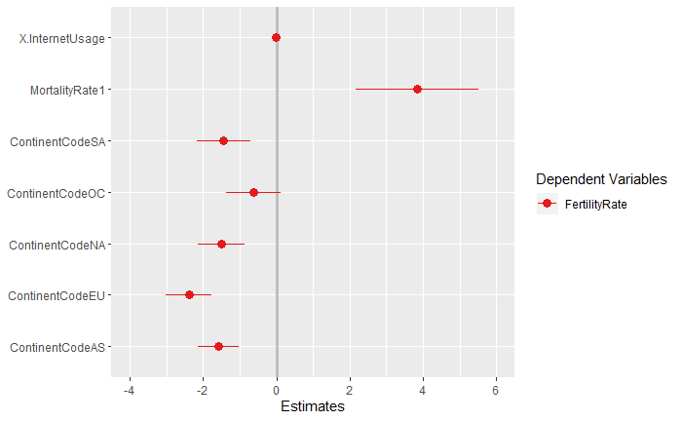
Regression (Hypo 2)

Slide 22
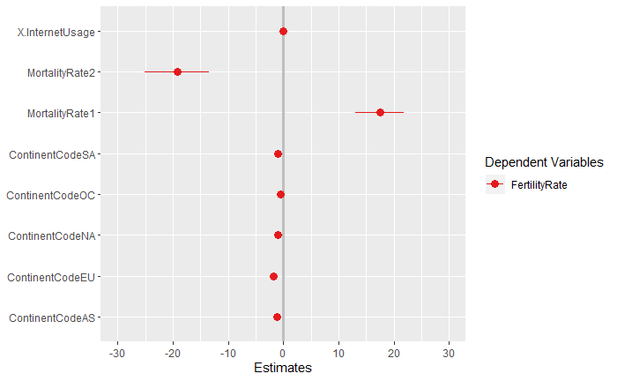
Regression (Hypo 4)

Slide 23
Regression (Hypo 4)
Predictive Approach Results:
Estimate Std. Error t value Pr(>|t|)
(Intercept) 2.154889 0.519485 4.148 6.74e-05 ***
MortalityRate1 15.873550 2.604365 6.095 1.76e-08 ***
MortalityRate2 -17.654878 3.312427 -5.330 5.50e-07 ***
X.InternetUsage 0.002775 0.008507 0.326 0.744910
ContinentCodeAS -1.096045 0.315731 -3.471 0.000748 ***
ContinentCodeEU -1.854045 0.365461 -5.073 1.66e-06 ***
ContinentCodeNA -1.079514 0.343678 -3.141 0.002177 **
ContinentCodeOC -0.443848 0.442612 -1.003 0.318224
ContinentCodeSA -1.195706 0.414742 -2.883 0.004762 **
RMSE Rsquared MAE
0.8337601 0.8029709 0.6536587

Slide 24


Recommendations
Notes:
Quality-of-life development indicators like Internet Usage may not be the best predictor of population dynamics in countries
The goal of decreasing fertility rates may be best served by focusing on contraceptive education, family planning education, and improved life expectancy instead of focusing on improvements in economic well-being like access to internet

